Slide 1
Shipping management application (sma)
Linan Zhang & Ming Zhao Shi

Slide 2
Purpose
The main purpose of this project is to provide admin of the shipping, post and express company the easiest way to retrieve customer’s information, calculate the delivery charges, track the package information, provide better service for the customer, and generate a detailed post/express report for both the customer and shipping company.

Slide 3
System functions
Function has been achieved
The work in the future
The techniques we used
Our system looks like……
We are still thinking about……

Slide 4
1. System functions

Slide 5
Functional Decomposition Diagram
Package category rate
Location rate
Shipping category rate
Package shipping charge
Total Charge
Weight
Shipping_charge = (package_category_rate + location_rate) *weight + shipping_category_rate;

Slide 6
Data flow diagram – DFD
Employee info
Customer info
Package info (weight,package category id,shipping category id,location id)
Get according rate from package category, shipping category, location table
Shipping charge
Final Report

Slide 7
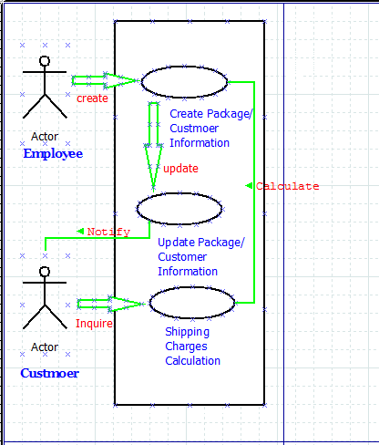
Use case diagram (actor)

Slide 8
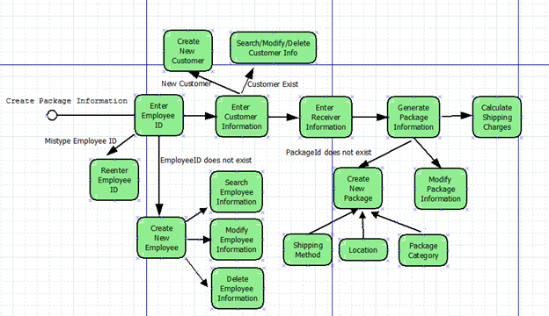
Activity diagram

Slide 9
2. Function has been achieved

Slide 10
Class diagram

Slide 11
3. The work in the future

Slide 12
Functions
Package Module
Shipping Method Module
Package Category Module
Location Module
Calculate Charge Module

Slide 13
Optimize The User Interface
Rich Interface Elements
Add Animation Effect
Add Application Theme

Slide 14
4. The techniques we used

Slide 15
The Techniques
Java
Oracle
PL/SQL

Slide 16
5. Our system looks like……

Slide 17
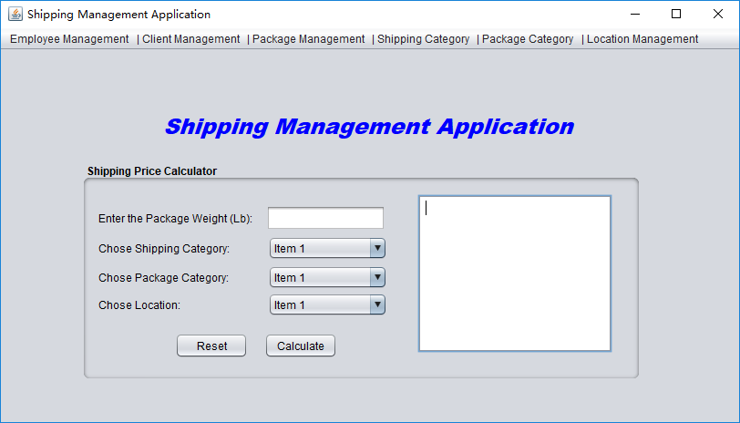
Main frame

Slide 18
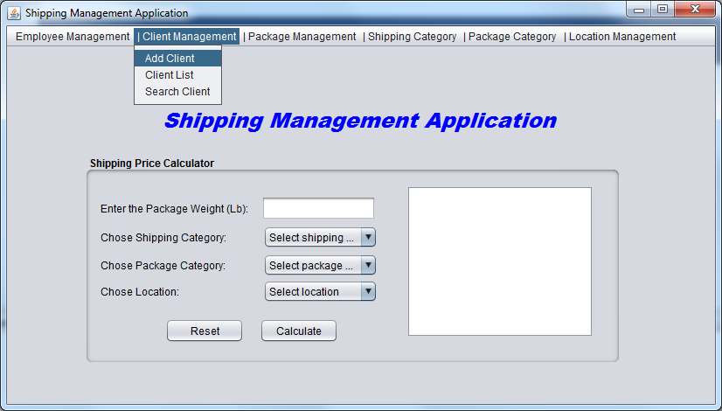
Client management

Slide 19
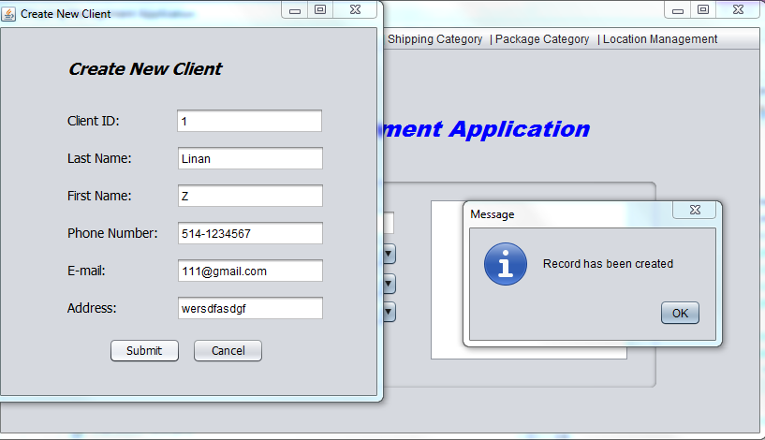
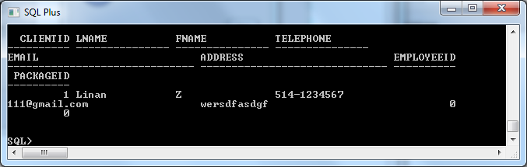
Client management_Add New client

Slide 20
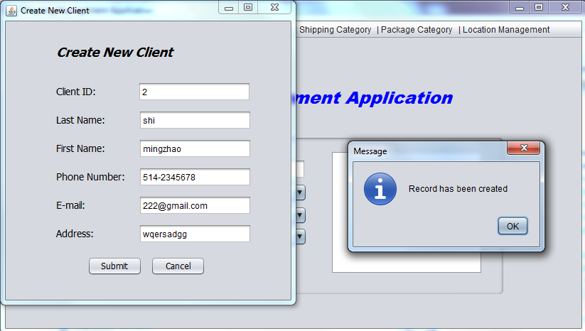
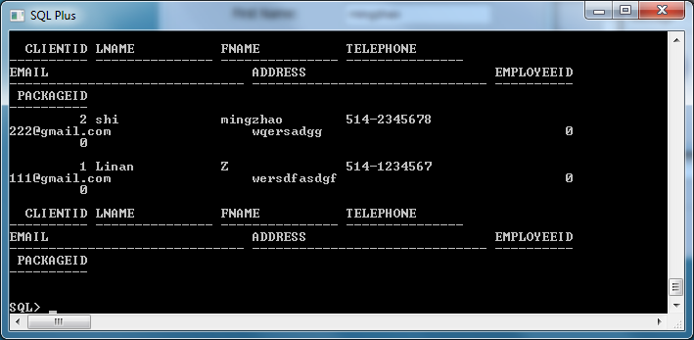
Client management_Add New client

Slide 21
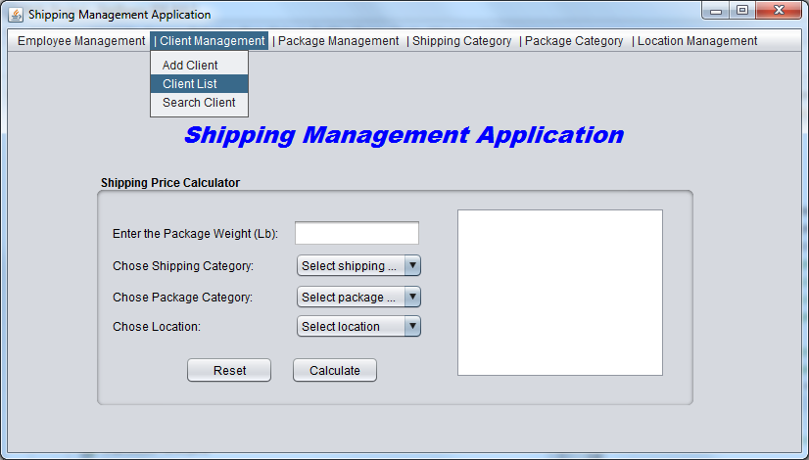
Client management_client List

Slide 22
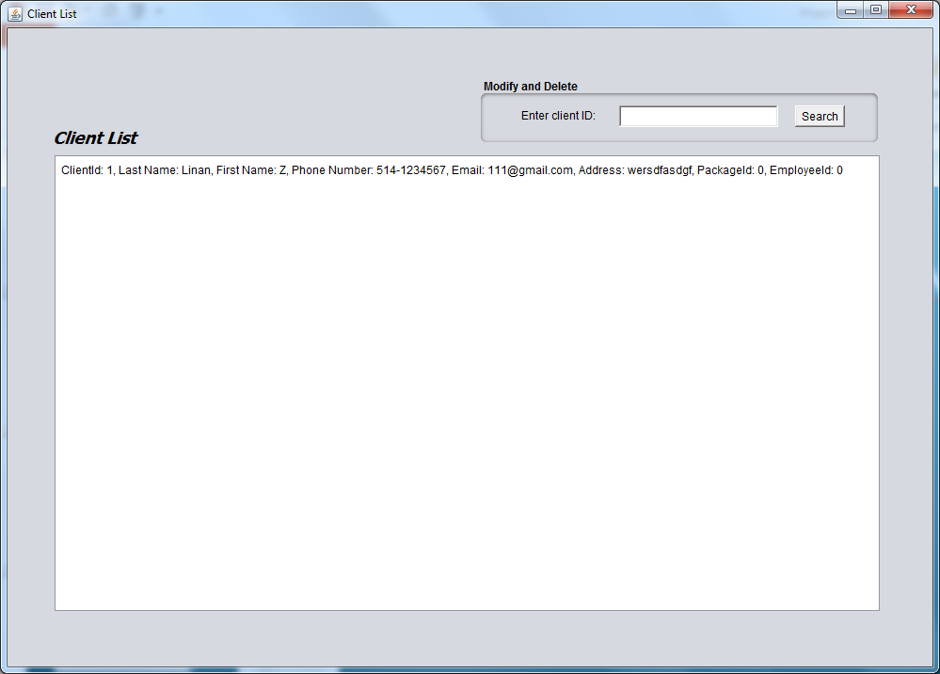
Client management_client List

Slide 23
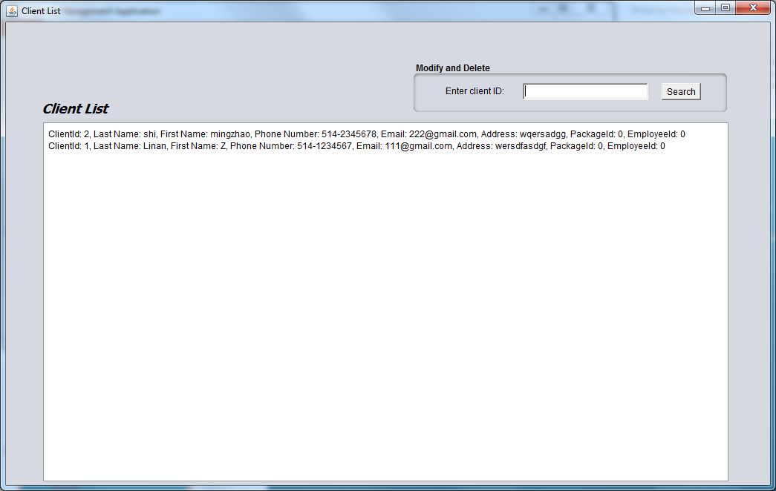
Client management_client List

Slide 24
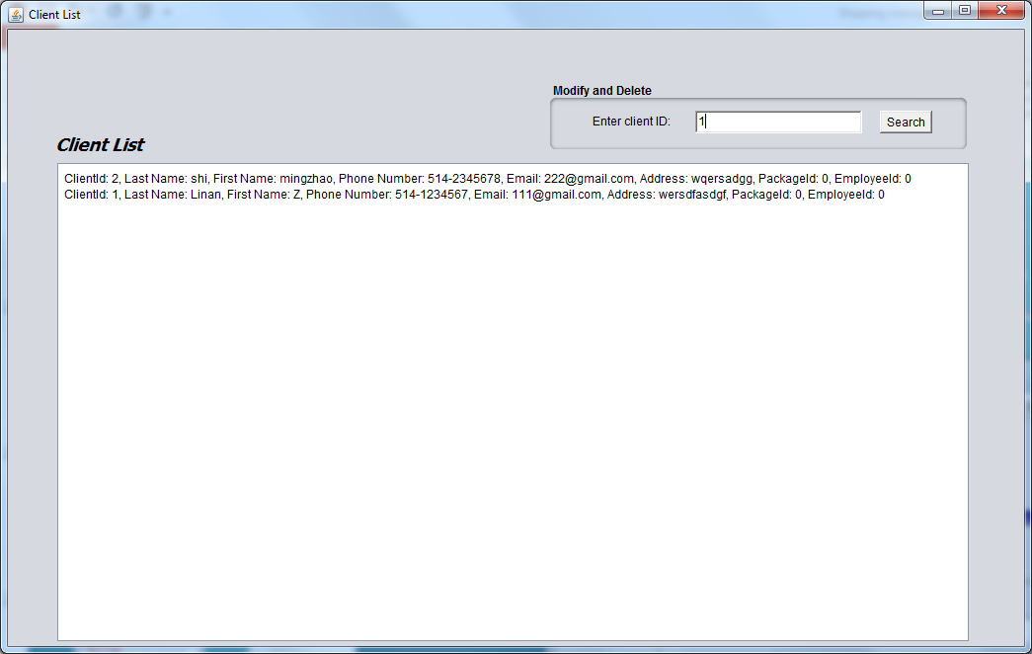
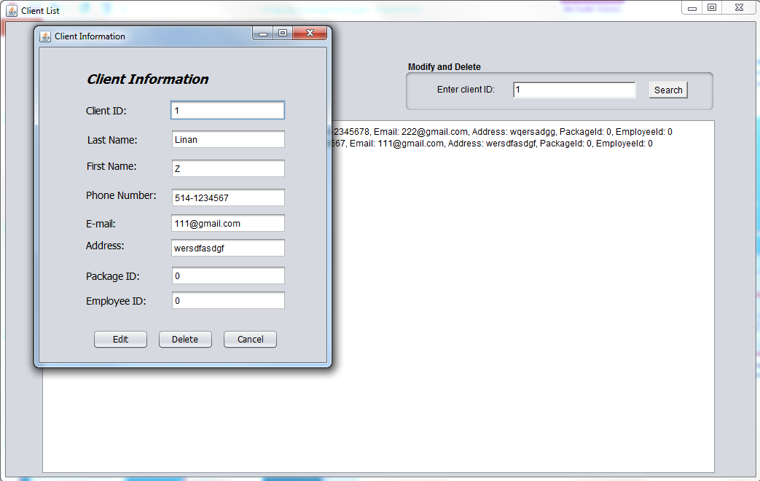
Client management_client List

Slide 25
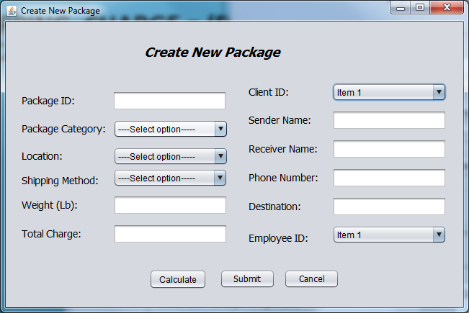
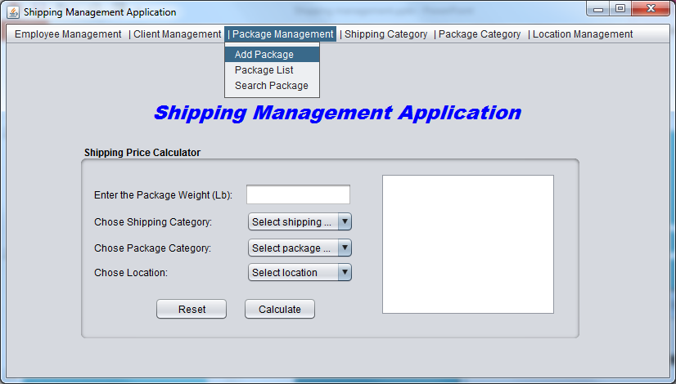
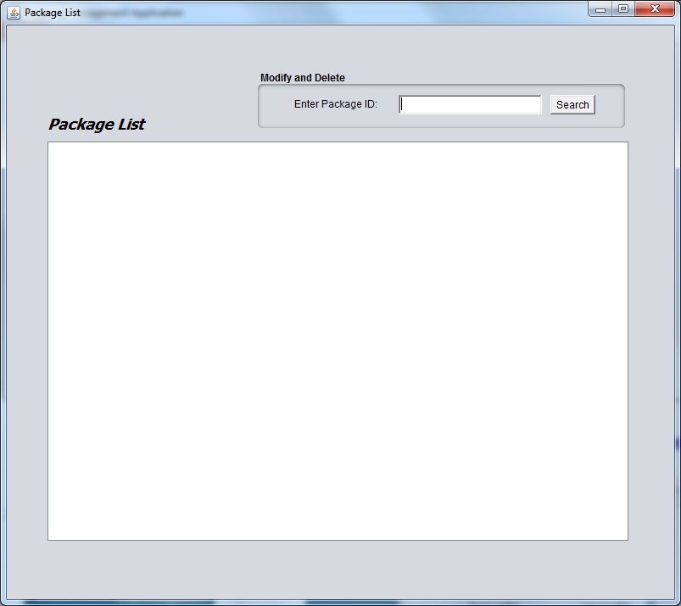
Add new package
Search package info

Slide 26
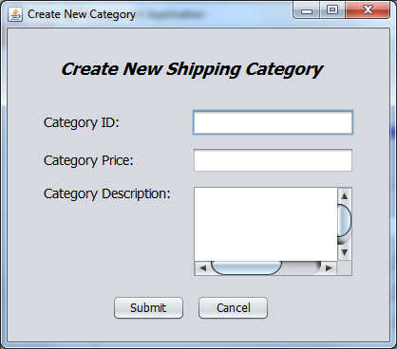
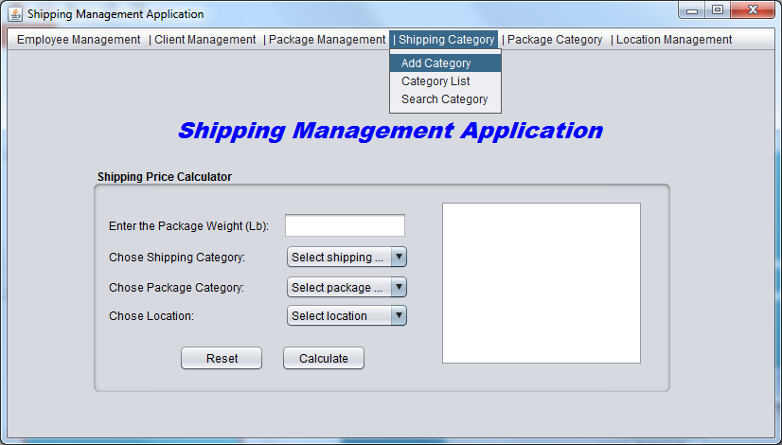
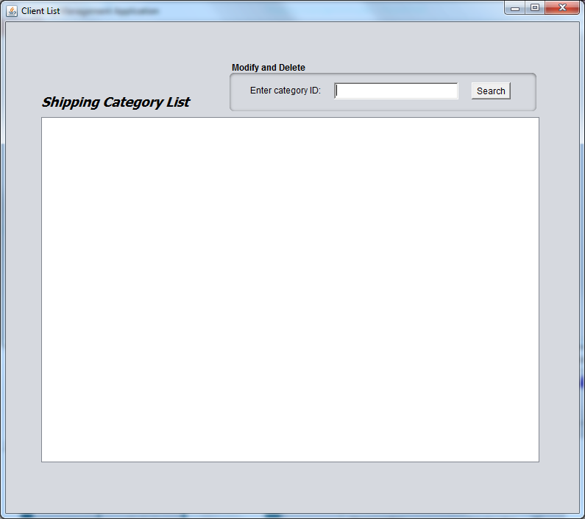
Add new category
Search category list

Slide 27
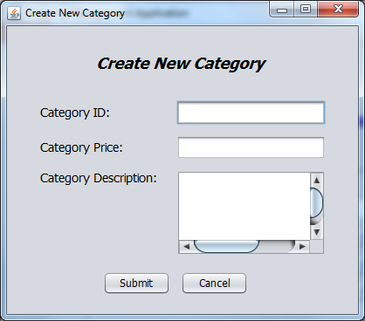
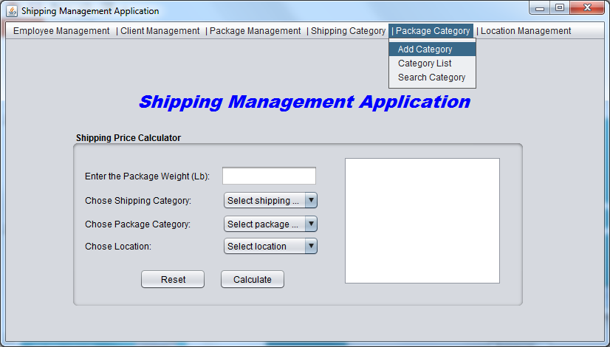
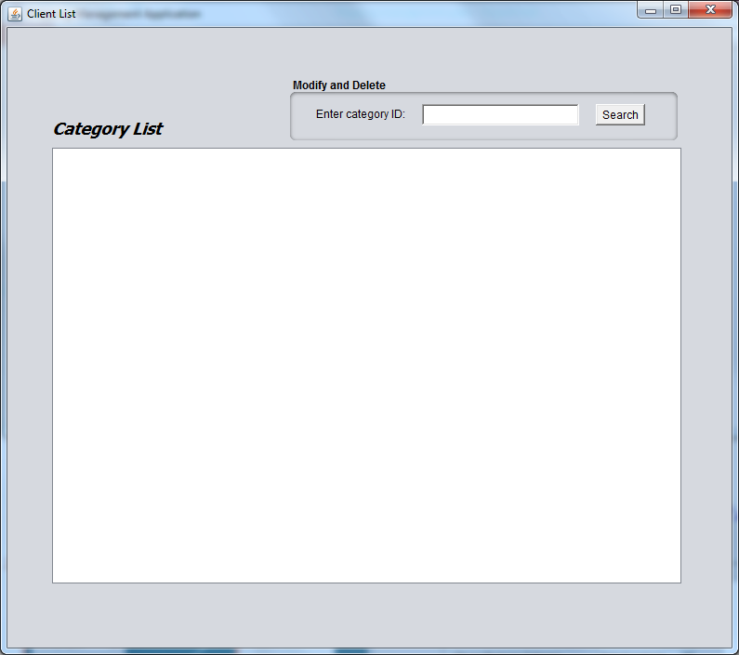
Add new package category
Search package category
info

Slide 28
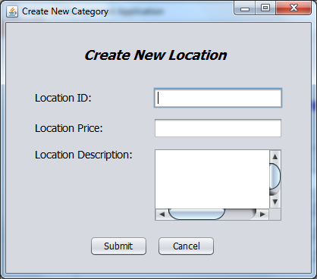
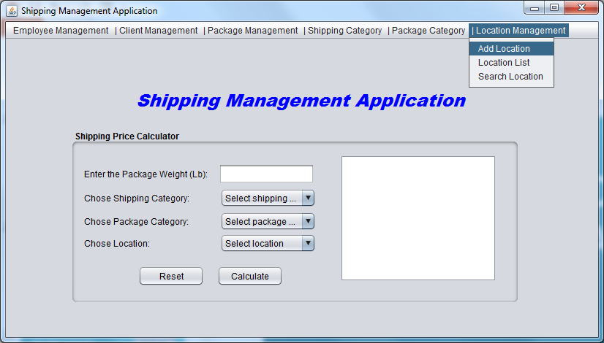
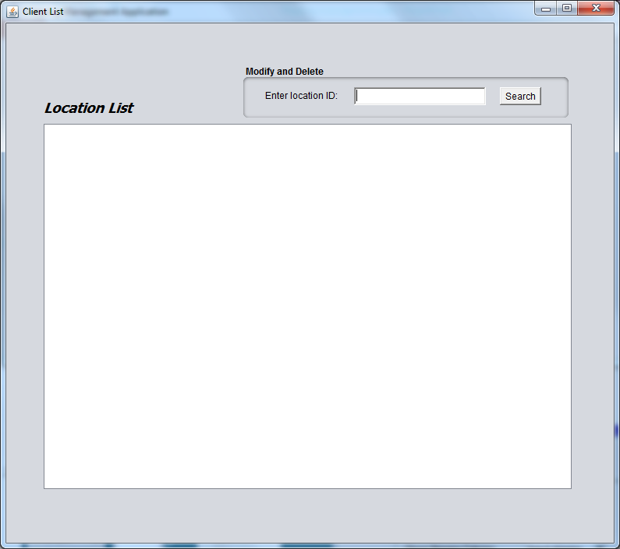
Add new Location
Search location info

Slide 29
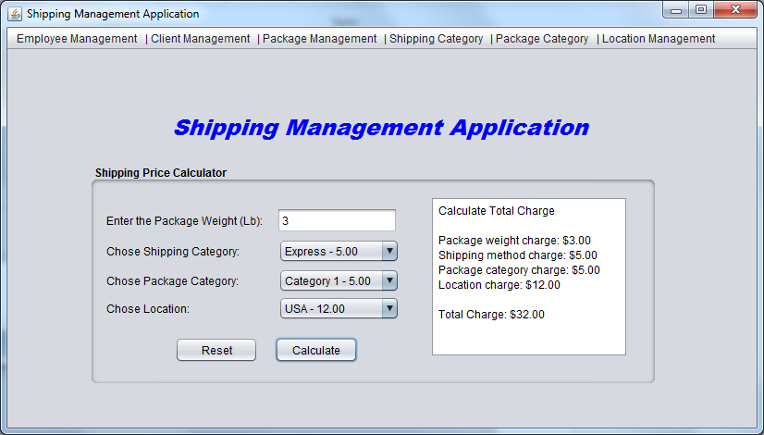
Shipping price calculation
Shipping_charge = (package_category_rate + location_rate) *weight + shipping_category_rate;

Slide 30
5. We are still thinking about……

Slide 31
The scope of the system
Who will use this system
Tracking package

Slide 32
The detail of the user interface
Exception handling
Make the operation sample

Slide 33
Thank you for your attendance

